Slide 1
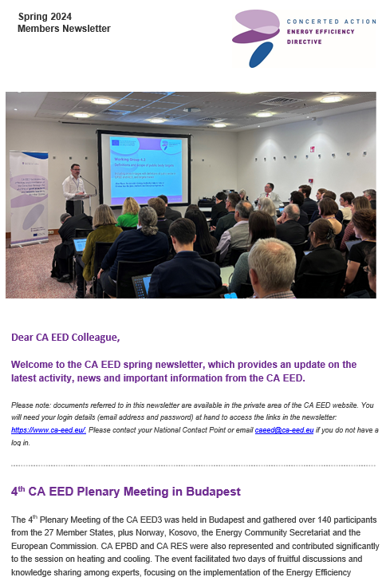
Upcoming comms activity – Ella/Katie
Public newsletter – 3rd May
Issue questionnaires – before 23rd May
5th Plenary Meeting invitation sent NCPs – end of May
Work with the web developer to design the interactive expert area / article tool on the website – over the summer.
16 hours of work for the developer
Can be billed under our rolling maintenance cost, however it would come out of the time that is used for general website maintenance.
Web developers have optimised search function for documents

Slide 2
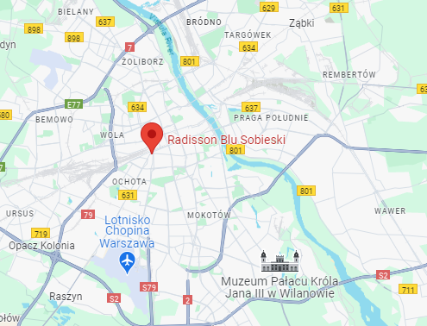
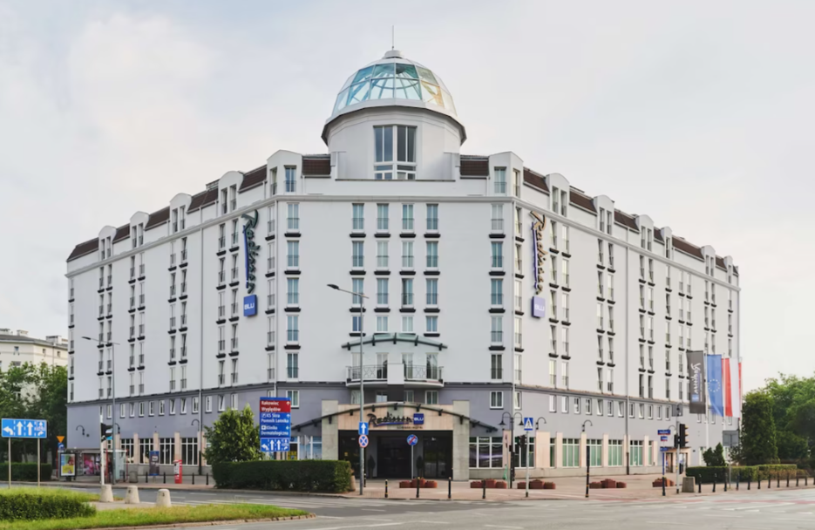
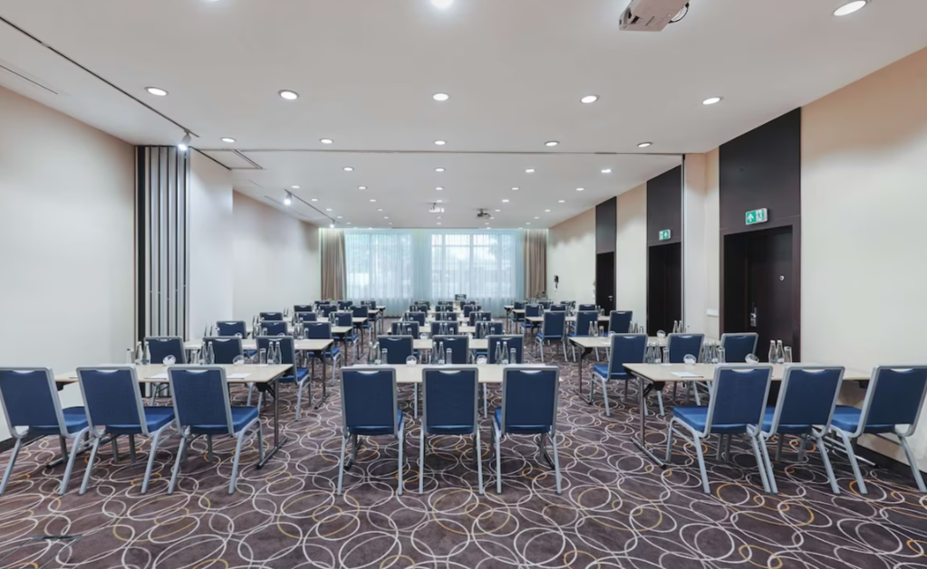
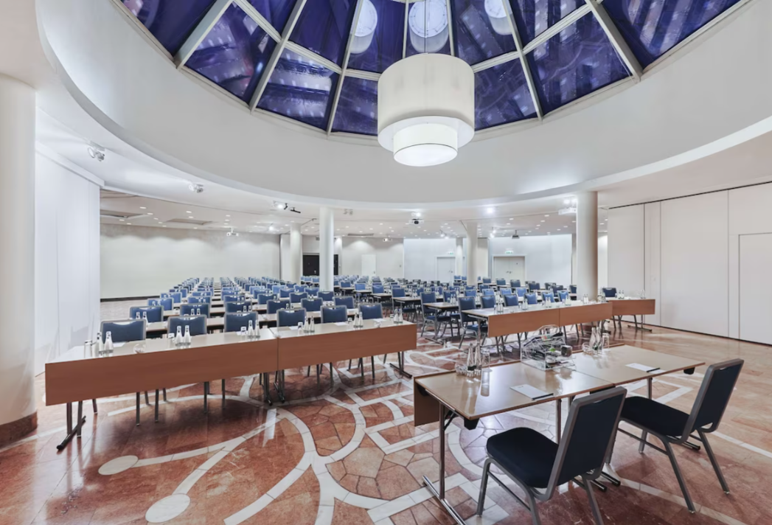
PM5 Venue – Warsaw
Venue:
Radisson Blu Sobieski
Parc Artura Zawiszy 1, Warsaw
Dates:
17 – 18 October 2024
Dinner:
Venue still to be confirmed
Transport:
METRO:
Rondo Daszyńskiego Station – 1,1km (7-minute walk)
TRAIN:
Ochota Train Station – 350m (5-minute walk)
Central Station - 1,5km (7 minute by tram)

